Slide 1
威世智中国员工及 组织化赛事介绍 WotC China Staff and Organized Play Instruction Shane Xu 2015.3

Slide 2
Good Afternoon

Slide 3
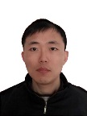
威世智中国团队
Wizards of the Coast Team China
Alex Zhou
Community Manager
China
Notes:
Korea Store Leader Joy Jeon on board in Jan.
China is recruiting 2 store leaders and they are expected to be on board in Q2 to provide the better and detailed service from the brand. (1 in April and 1 in May)
Ready to foster the high-quality Advanced store to reach the Advanced Plus Level.

Slide 4
零售支持团队
Retail Support Team
宋轶 Mark Song
WPN零售支持主管
WPN高级进阶店铺
徐钢
Alex Xu
安徽
江苏
上海
浙江
河南
山东
山西
陕西
重庆
四川
尚翼亮
Frank Shang
黑龙江
吉林
辽宁
湖北
湖南
江西
福建
广东
广西
贵州
云南
王云涛
Yuntao Wang
北京
天津
河北
内蒙古
甘肃
宁夏
青海
新疆
Notes:
Korea Store Leader Joy Jeon on board in Jan.
China is recruiting 2 store leaders and they are expected to be on board in Q2 to provide the better and detailed service from the brand. (1 in April and 1 in May)
Ready to foster the high-quality Advanced store to reach the Advanced Plus Level.

Slide 5
组织化赛事
Organized Play (OP)
鹏洛客
积分
普通 赛事
WPN 计划
店内重要赛事
重要 赛事
Notes:
Slide 2: WPN Metrics YTD Part 1
China’s distribution is in 29 provinces, need to focus on the 2nd tier potential cities in 2014.
Need to develop new channel to expand coverage by pioneering PC room (digital game place)

Slide 6
赛事比重
Weight by Event Catalog
WPN计划：比赛数量最多
重要赛事：平均参赛人数最多
Notes:
So lets see the components of the event types and how much do they weight in the entire Organized Play system. These two graphs is stats of all events run in Korea in 2014. On the graph you may find, the most weighted program is Friday Night Magic. Yes, almost half of our events are Friday Night Magic. So Friday Night Magic is a very important part of our events. Also, per the stats, each Premier Events (GPTs, PTQs, WMCQs) will have about 24 players played in these events in average, which is 2.4 times of all other events. That means Premier Events are events with the best quality and attract players most.

Slide 7
WPN计划
WPN Program
WPN计划
周五认证赛 Friday Night Magic
售前赛 Prerelease
欢乐日 Magic Game Day
Notes:
Slide 2: WPN Metrics YTD Part 1
China’s distribution is in 29 provinces, need to focus on the 2nd tier potential cities in 2014.
Need to develop new channel to expand coverage by pioneering PC room (digital game place)

Slide 8
WPN计划关键词 – 娱乐 Keyword of WPN Program - Entertainment

Slide 9
WPN计划的比重
Weight of WPN Program
FNM: 比赛数量最多的赛事类型
Prerelease：平均参赛人数最多的WPN计划
Notes:
So lets see the components of the event types and how much do they weight in the entire Organized Play system. These two graphs is stats of all events run in Korea in 2014. On the graph you may find, the most weighted program is Friday Night Magic. Yes, almost half of our events are Friday Night Magic. So Friday Night Magic is a very important part of our events. Also, per the stats, each Premier Events (GPTs, PTQs, WMCQs) will have about 24 players played in these events in average, which is 2.4 times of all other events. That means Premier Events are events with the best quality and attract players most.

Slide 10
周五认证赛
Friday Night Magic
必须于每周五举行
可以举行任何赛制（标准构筑，轮抓，现开，摩登。。。诡局，薪传，指挥官等）
每周可以申请3场竞争赛制和3场休闲赛制
根据店铺等级分配纪念闪卡
店铺可以自行设定发放方式
周五认证赛申请窗口：2个月前的7日-1个月前的7日
Notes:
Slide 2: WPN Metrics YTD Part 1
China’s distribution is in 29 provinces, need to focus on the 2nd tier potential cities in 2014.
Need to develop new channel to expand coverage by pioneering PC room (digital game place)

Slide 11
售前赛
Prerelease
每个常规系列发售前一周的周末举行
现开或双头巨人现开
使用售前现开组合
在售前赛结束后到正式发售前，不得销售多余的售前组合
售前赛申请窗口：售前赛前8周-售前赛前5周
Notes:
Slide 2: WPN Metrics YTD Part 1
China’s distribution is in 29 provinces, need to focus on the 2nd tier potential cities in 2014.
Need to develop new channel to expand coverage by pioneering PC room (digital game place)

Slide 12
欢乐日
Game Day
每个常规系列发售后三周的周末举行
标准构筑
售前赛申请窗口：售前赛前8周-售前赛前5周
Notes:
Slide 2: WPN Metrics YTD Part 1
China’s distribution is in 29 provinces, need to focus on the 2nd tier potential cities in 2014.
Need to develop new channel to expand coverage by pioneering PC room (digital game place)

Slide 13
WPN店内重要赛事
WPN In Store Premier Events
WPN店内重要赛事
大奖赛预选赛 GPT
初选/地区专业赛资格赛 PPTQ/RPTQ
世界杯资格赛 WMCQ
仅针对WPN高级和高级进阶店铺
Notes:
Slide 2: WPN Metrics YTD Part 1
China’s distribution is in 29 provinces, need to focus on the 2nd tier potential cities in 2014.
Need to develop new channel to expand coverage by pioneering PC room (digital game place)

Slide 14
WPN店内重要赛事关键词 – 通往PT之路 Keyword of WPN In Store Premier Events – Road to Pro Tour

Slide 15
重要赛事结构 Premier Event Structure
专业赛(PT)
Pro Tour
大奖赛(GP)
Grand Prix
世界杯(WMC)
World Magic Cup
地区专业资格赛(RPTQ)
Regional Pro Tour Qualifier
专业资格赛 (PTQ)
Pro Tour Qualifier
大奖预选赛
(GPT)
Grand Prix Trial
世界杯资格赛(WMCQ)
World Magic Cup Qualifier
初选专业资格赛(PPTQ)
Preliminary Pro Tour Qualifier
Notes:
OK, now let’s talk about Premier Events.
This is a structure chart for Premier Events. Pro Tour is the top tier event type in Magic’s world. There are several ways for players to get a ticket to Pro Tour. And every road to PT is connected with WPN stores.
In 2015, we made some changes to make this system more suitable for WPN stores.
We changed PTQ to a 2nd level events: PPTQs and RPTQs. It can make more stores join PTQ program and become the 1st step of a player’s road to PT.
Also, stores may run GPTs more often and with more choice.
Remember, all of these benefits are for advanced and advanced+ stores only. If you’re not achieved these levels, try to expand your player community and make these events the best reward for your players.

Slide 16
大奖赛预选赛
Grand Prix Trial
冠军获得对应GP两轮轮空
每家店铺每个月举办一场GPT
没有对应GP的区域限制，也不限制数量
必须有1级+裁判
GPT申请窗口：GP 12周前的7日-下个月的7日
Notes:
Slide 2: WPN Metrics YTD Part 1
China’s distribution is in 29 provinces, need to focus on the 2nd tier potential cities in 2014.
Need to develop new channel to expand coverage by pioneering PC room (digital game place)

Slide 17
初选专业资格赛
Preliminary PTQ
冠军获得对应RPTQ参赛资格
每家店铺每场PT举办可以举办一场PTQ
必须有2级+裁判
PPTQ申请窗口：见公告
Notes:
Slide 2: WPN Metrics YTD Part 1
China’s distribution is in 29 provinces, need to focus on the 2nd tier potential cities in 2014.
Need to develop new channel to expand coverage by pioneering PC room (digital game place)

Slide 18
地区专业资格赛
Regional PTQ
前4名获得对应PT参赛资格及往返机票
（若参赛人数超过128人则改为前8名）
WotC选择优秀的店铺举办RPTQ
强烈建议有3级+裁判
Notes:
Slide 2: WPN Metrics YTD Part 1
China’s distribution is in 29 provinces, need to focus on the 2nd tier potential cities in 2014.
Need to develop new channel to expand coverage by pioneering PC room (digital game place)

Slide 19
世界杯资格赛
World Magic Cup Qualifier
每个合格国家每年举办三场WMCQ
冠军入选国家队，获得WMC参赛资格及 往返机票
WotC选择优秀的店铺举办WMCQ
强烈建议有3级+裁判
Notes:
Slide 2: WPN Metrics YTD Part 1
China’s distribution is in 29 provinces, need to focus on the 2nd tier potential cities in 2014.
Need to develop new channel to expand coverage by pioneering PC room (digital game place)

Slide 20
普通比赛 – 竞技与休闲
Magic Events – Competitive and Casual
竞争比赛
8人以上
竞争性积分及终生积分
休闲活动
任何人数
终生积分
竞争性赛制
任何赛制（指挥官、诡局等）
需要完整录入成绩
只需要录入参加牌手
Notes:
Slide 2: WPN Metrics YTD Part 1
China’s distribution is in 29 provinces, need to focus on the 2nd tier potential cities in 2014.
Need to develop new channel to expand coverage by pioneering PC room (digital game place)

Slide 21
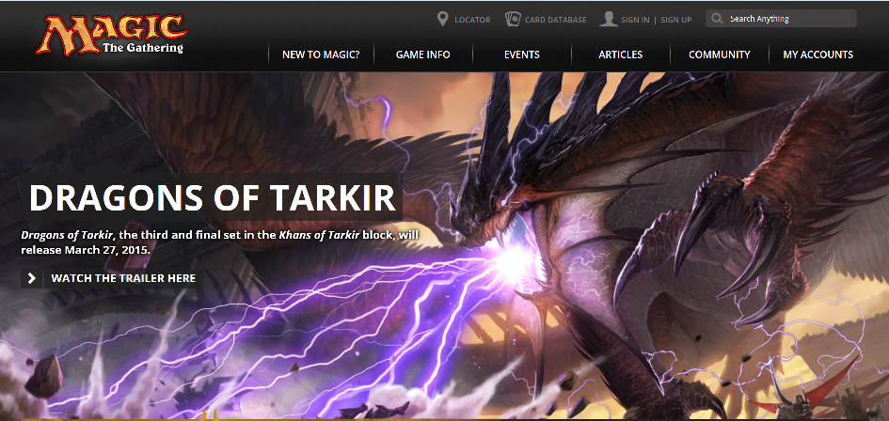
新万智牌网站
New Magic Website
www.wizards.com/magic
Notes:
Slide 2: WPN Metrics YTD Part 1
China’s distribution is in 29 provinces, need to focus on the 2nd tier potential cities in 2014.
Need to develop new channel to expand coverage by pioneering PC room (digital game place)

Slide 22
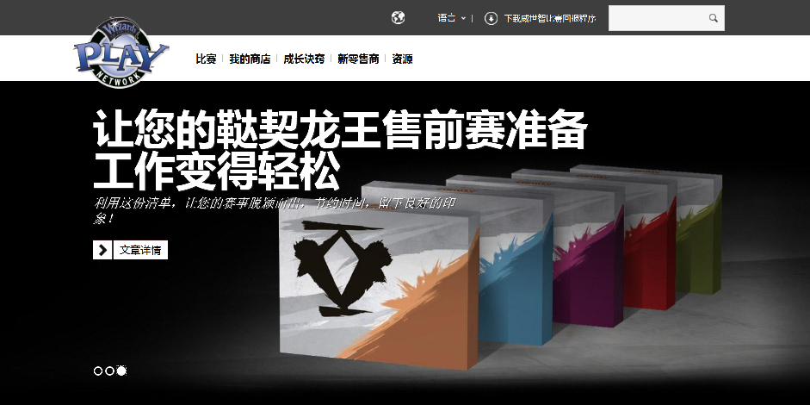
新WPN网站
New WPN Website
www.wizards.com/magic
Notes:
Slide 2: WPN Metrics YTD Part 1
China’s distribution is in 29 provinces, need to focus on the 2nd tier potential cities in 2014.
Need to develop new channel to expand coverage by pioneering PC room (digital game place)

Slide 23
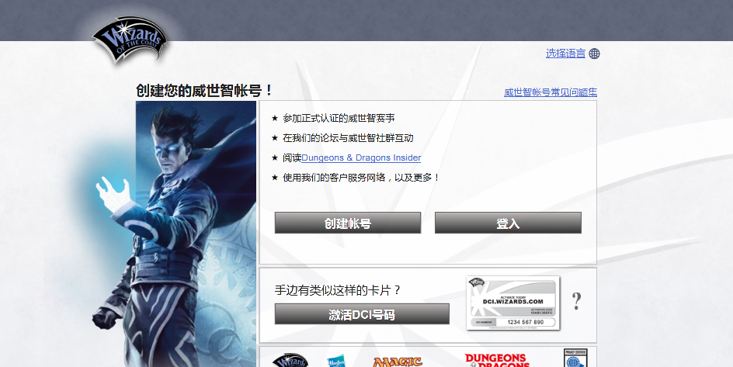
新威世智账号（新牌手注册）
New Wizards Account (NPSU)
accounts.wizards.com
Notes:
Slide 2: WPN Metrics YTD Part 1
China’s distribution is in 29 provinces, need to focus on the 2nd tier potential cities in 2014.
Need to develop new channel to expand coverage by pioneering PC room (digital game place)

Slide 24
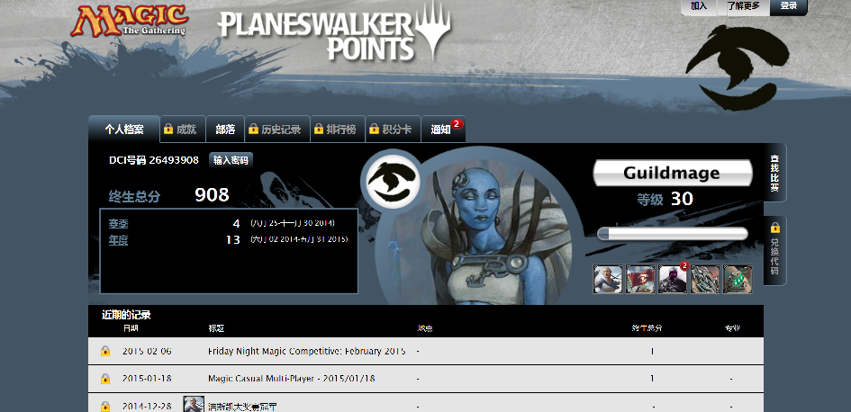
鹏洛客积分
Planeswalker Points
www.wizards.com/planeswalker
Notes:
Slide 2: WPN Metrics YTD Part 1
China’s distribution is in 29 provinces, need to focus on the 2nd tier potential cities in 2014.
Need to develop new channel to expand coverage by pioneering PC room (digital game place)

