Slide 1
MTG 英文
江爱力

Slide 2
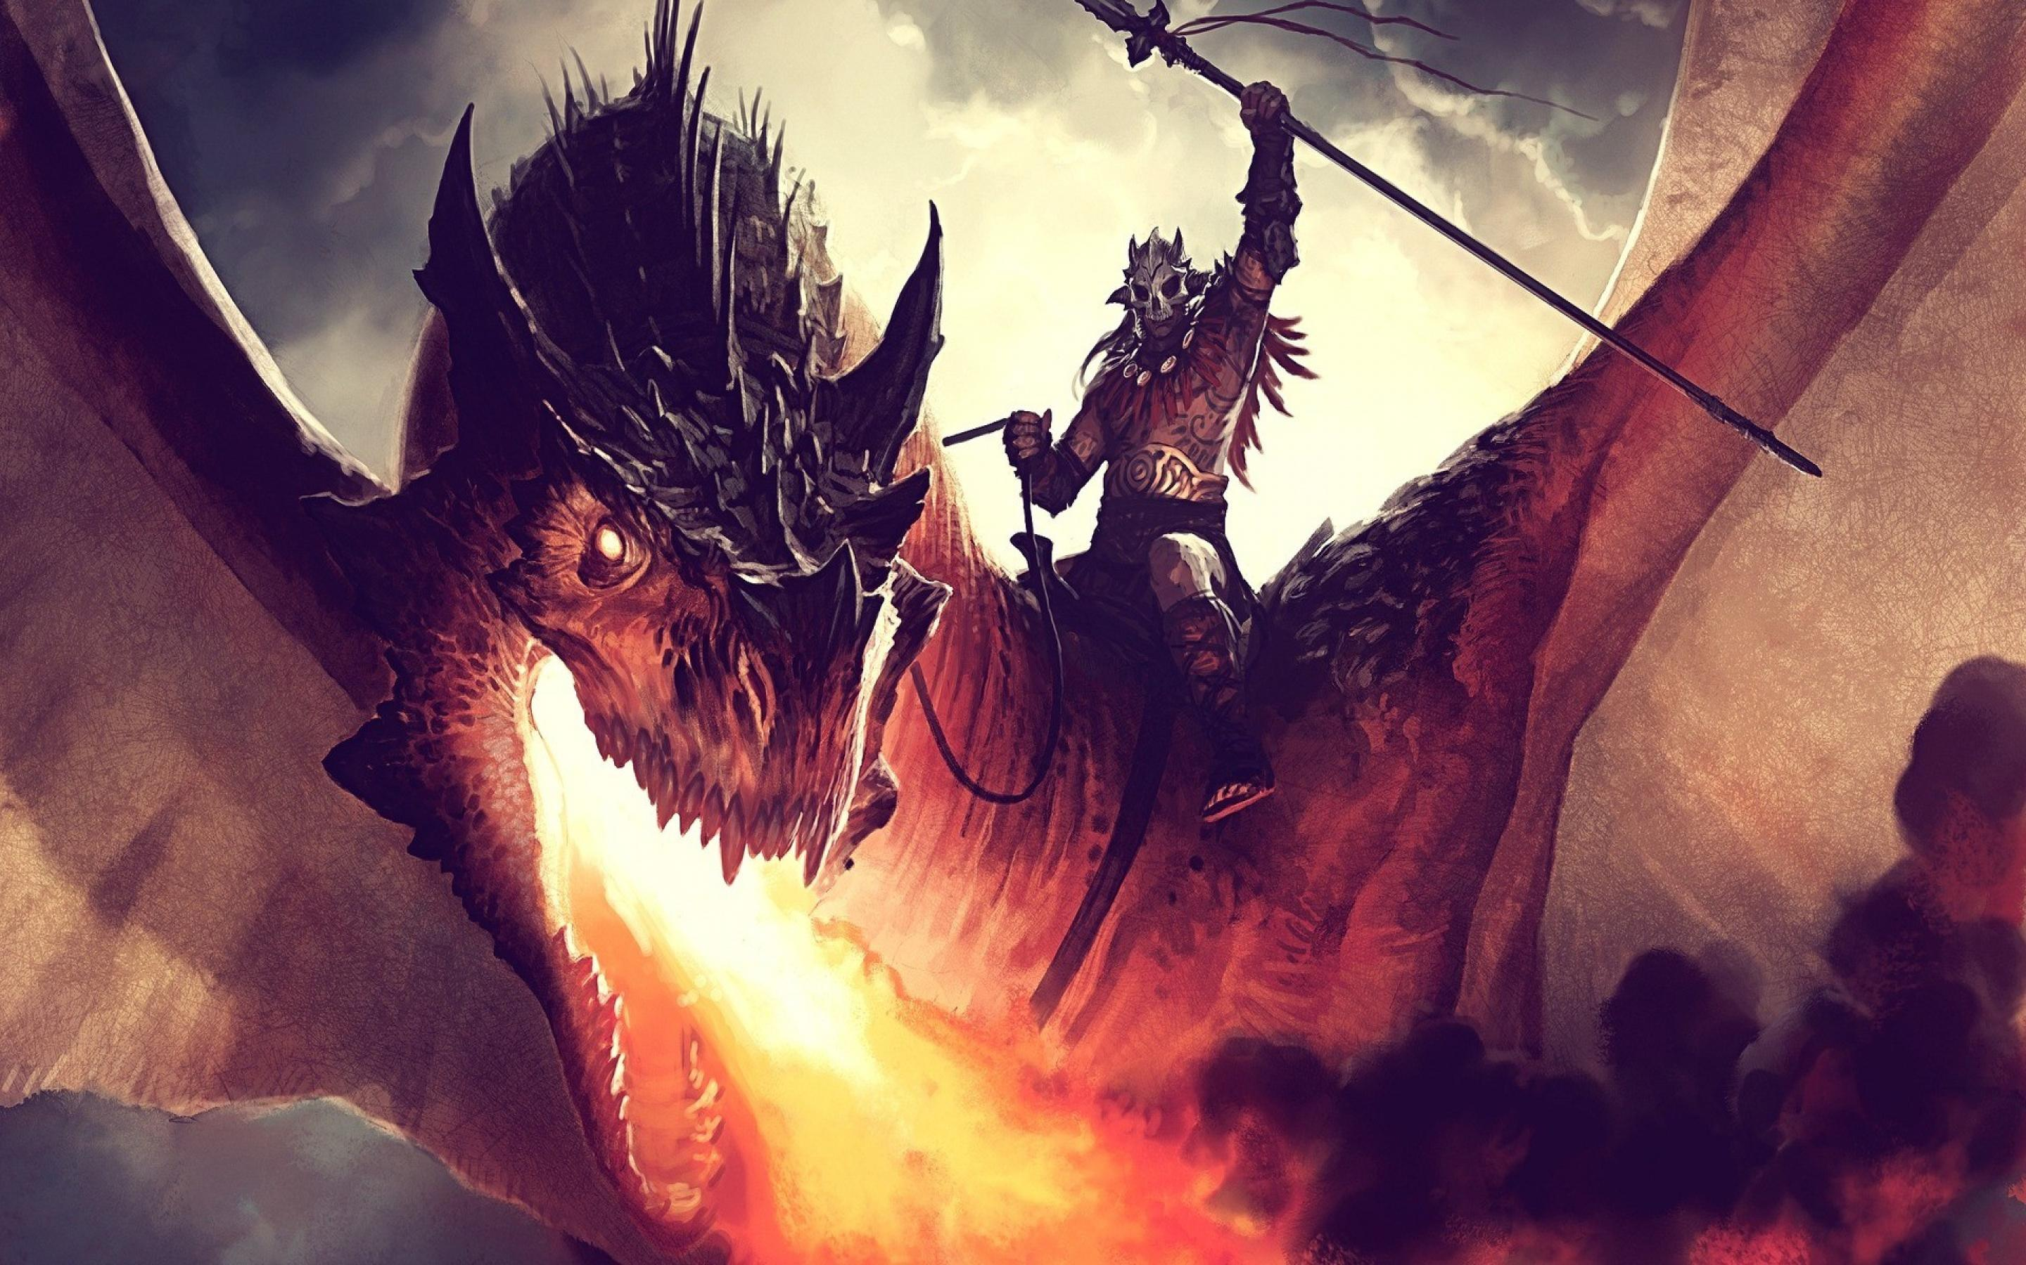
我们为什么需要MTG英文？
MTG is the world’s largest and most popular TCG
Popularity and Internationalization
Internationalization works both ways
Complicated board states
MTG-specific terms and slang
Examples

Slide 3
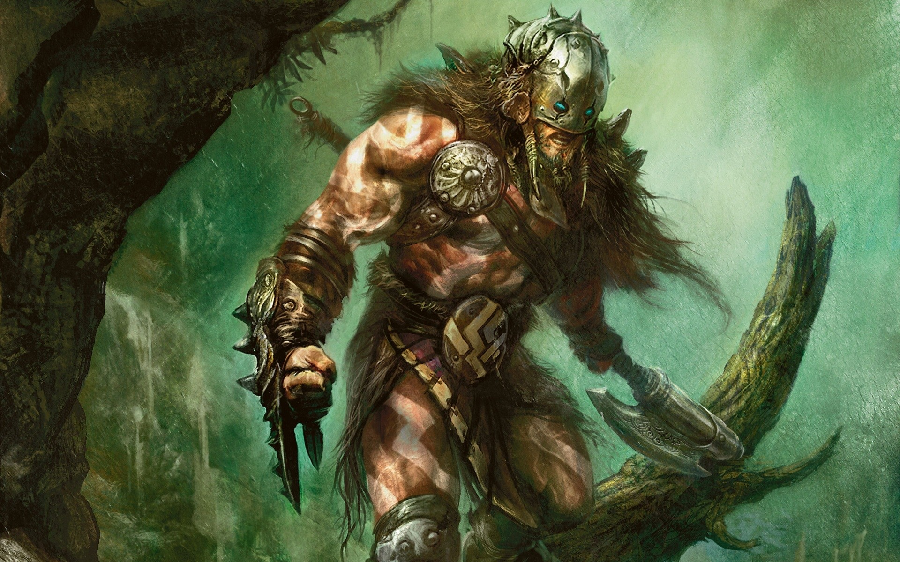
知道MTG英文有什么好处？
扩大你的当地社区 – 欢迎没说中文的牌手
Travel, staffing for GPs, etc.
Practicing MTG English can help you improve your non-MTG English
Involvement in judge projects
Increased interaction with
global judge community

Slide 4
Answering a Judge Call
英文裁判 – 中文问题 /// 中文裁判 - 英文问题
At an event with multiple judges, you still take the call and make the ruling, just ask for a translator to help you.
Ask the player to speak slowly and to use gestures to help explain the situation
Some players get concerned that a judge call will take time away from their match and that they won’t get extra time.
Be calm and confident.
Assure them that you will add extra time to their match and ask them to take their time to explain the situation.
It’s better to provide good customer service and take an extra minute or two than it is to rush a call in order to ‘speed up the tournament’
Oracle

Slide 5
套牌调查
What do you do if you have to do a deck check completely in a language you don’t know? (Italian, Russian, etc.)
Limited
You can use the collector’s number and artwork to speed up a deck check
Constructed
Familiarize yourself with the format

Slide 6
MTG English terms you DO need to know
Head Judge Announcement
Welcome
Introduction
Decklists
# of players
# of rounds
REL
Time for round
Tardiness penalties
Venue Information
Shuffle thoroughly
Pile shuffle
Play quickly
Communication
Call for a Judge!
Have fun!

Slide 7
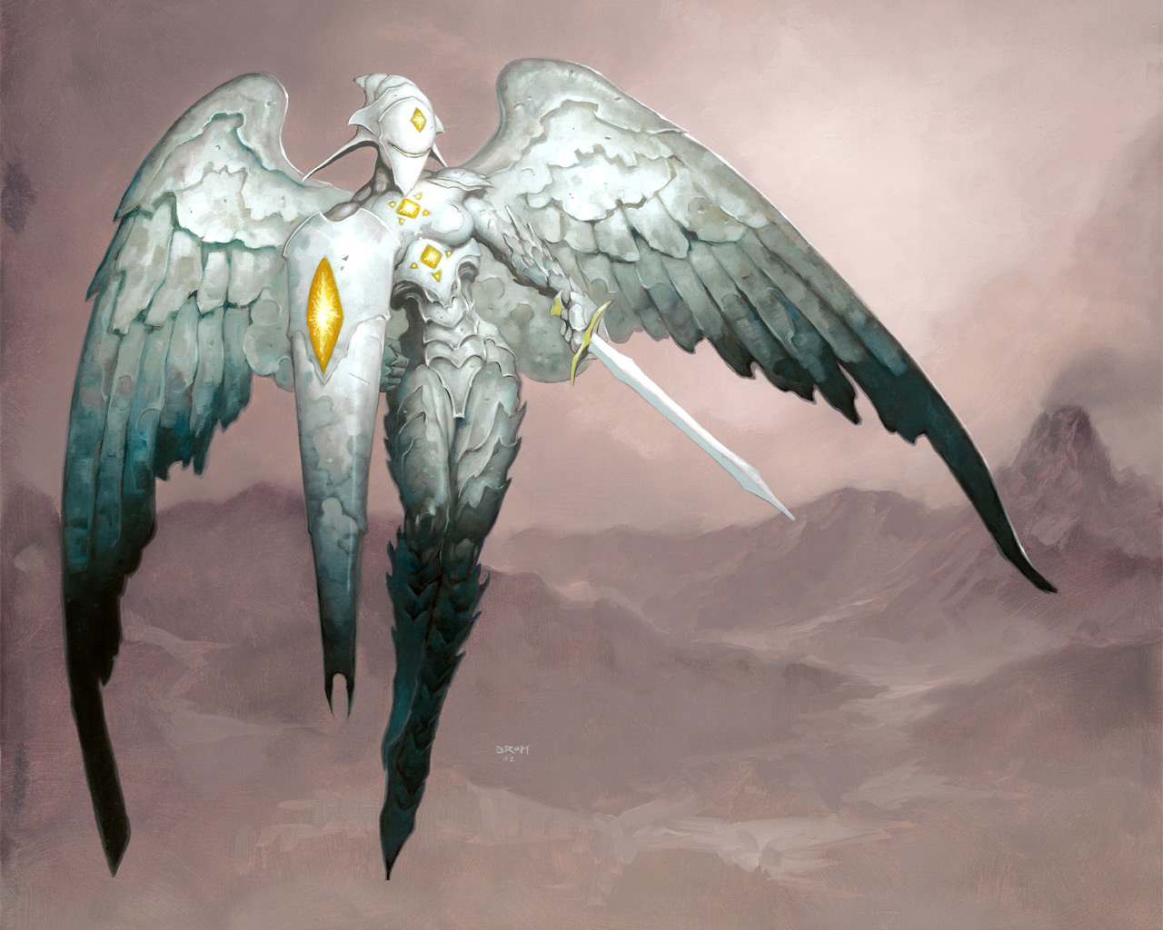
MTG English terms you DO need to know
Head Judge Announcement
Penalties
Warning
Game Loss
Match Loss
Appeal
Delivering a penalty

Slide 8
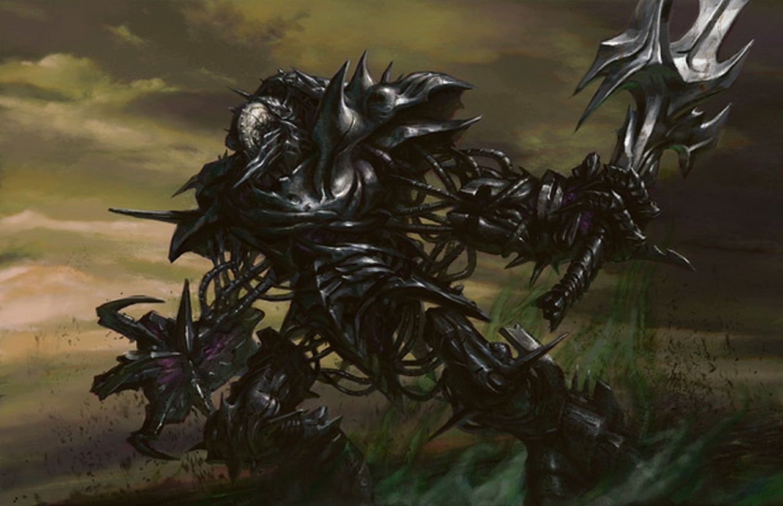
MTG English terms you DO need to know
Head Judge Announcement
Penalties
Parts of a Turn
Untap
Upkeep
Draw
Main Phase
Beginning of Combat
Declare Attackers
Declare Blockers
Combat Damage
End of Combat
(Second Main Phase!)
End Step
Clean Up Step

Slide 9
MTG English terms you DO need to know
Head Judge Announcement
Penalties
Parts of a Turn
Basic Card Types
Artifact
Creature
Enchantment
Instant
Land
Planeswalker
Sorcery
Tribal
(and more…)

Slide 10
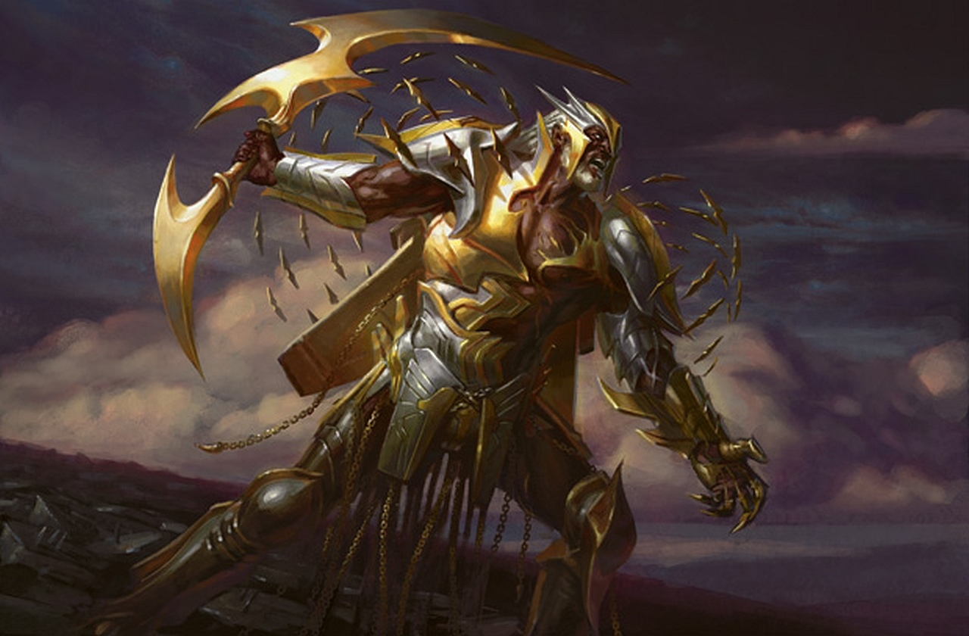
MTG English terms you DO need to know
Head Judge Announcement
Penalties
Parts of a Turn
Basic Card Types
Zones
Library
Hand
Battlefield
Graveyard
Stack
Exile
Command

Slide 11
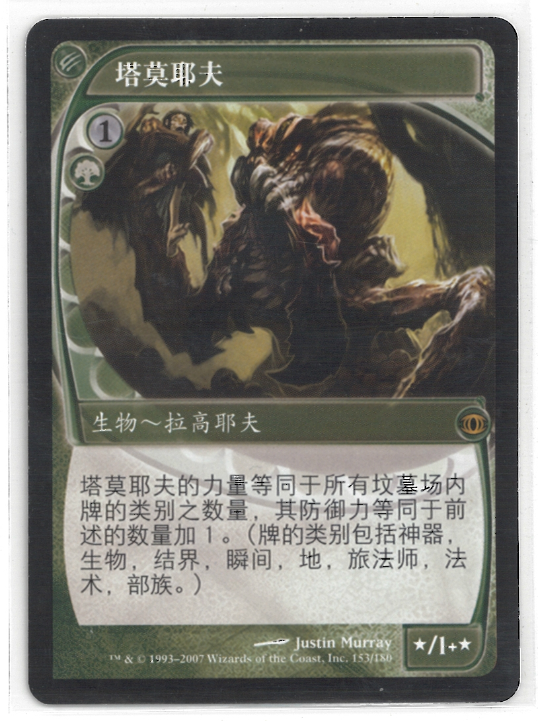
MTG English terms you DON’T need to know
Specific Card Names

Slide 12
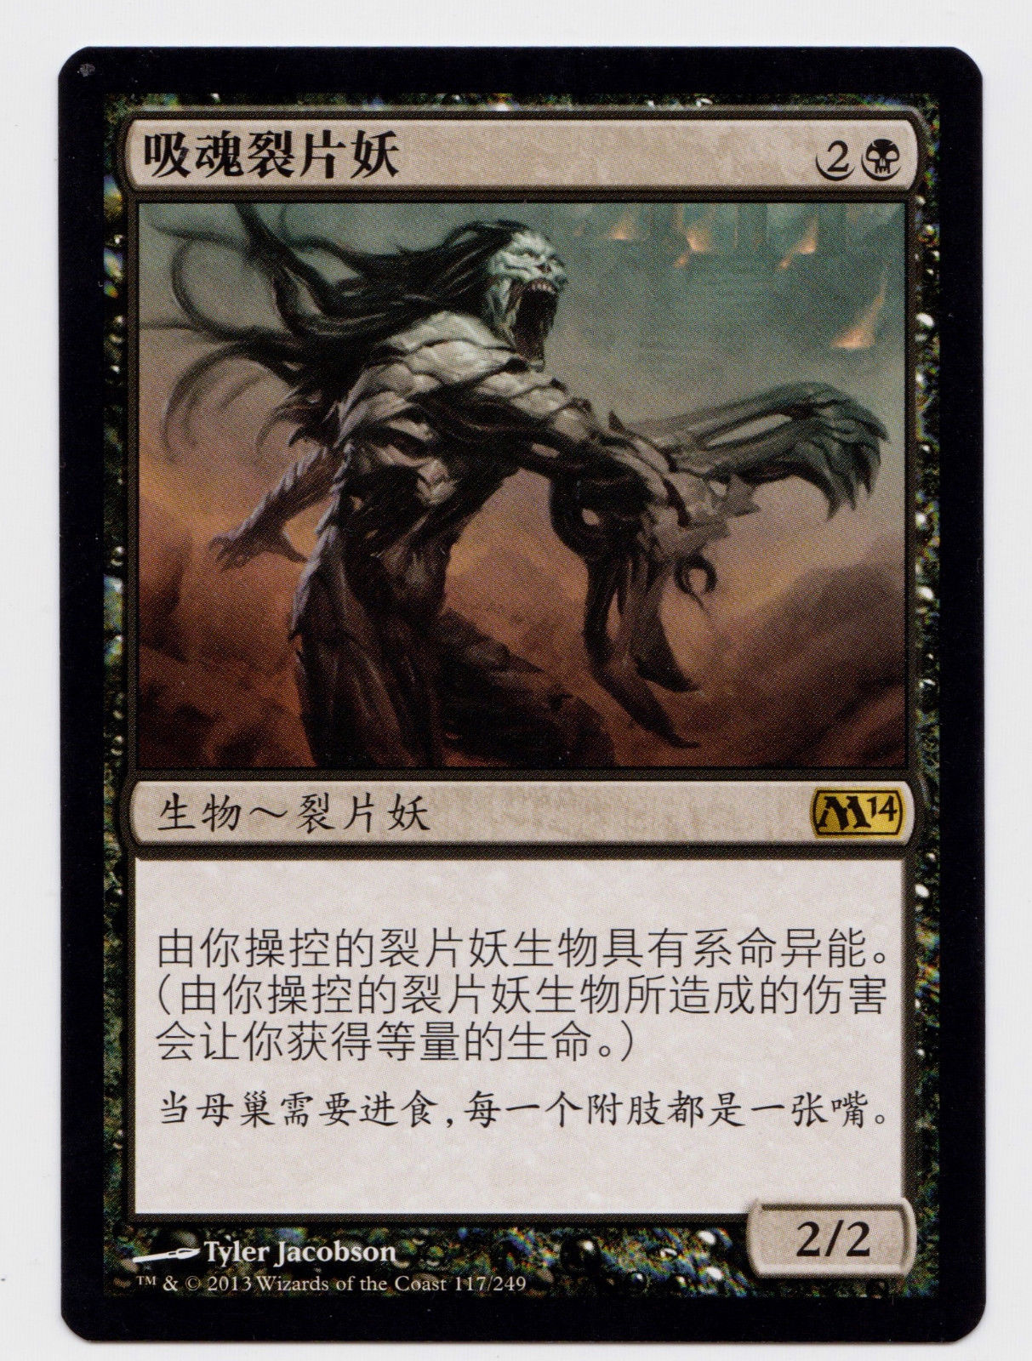
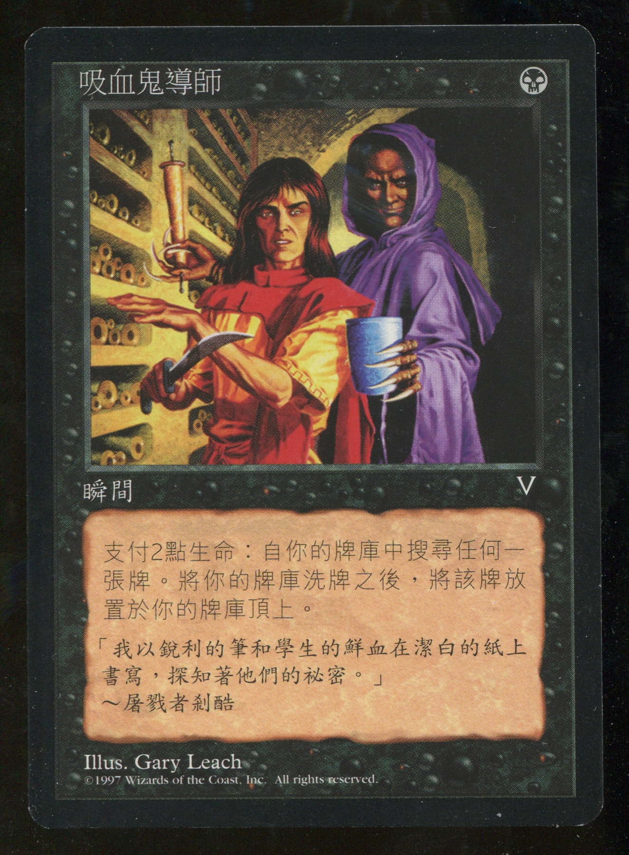

Slide 13
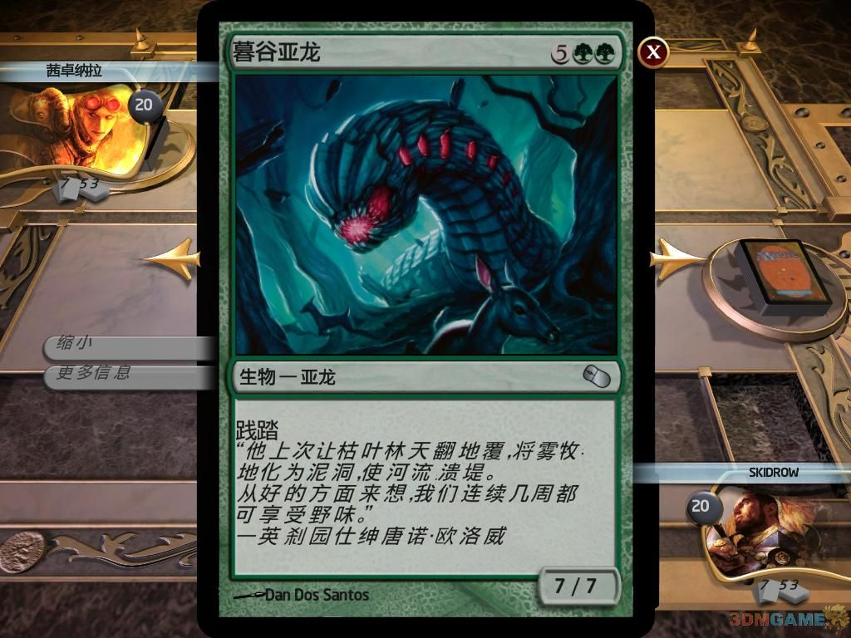
MTG English terms you DON’T need to know
Specific Card Names
Specific Abilities
and Keywords

Slide 14
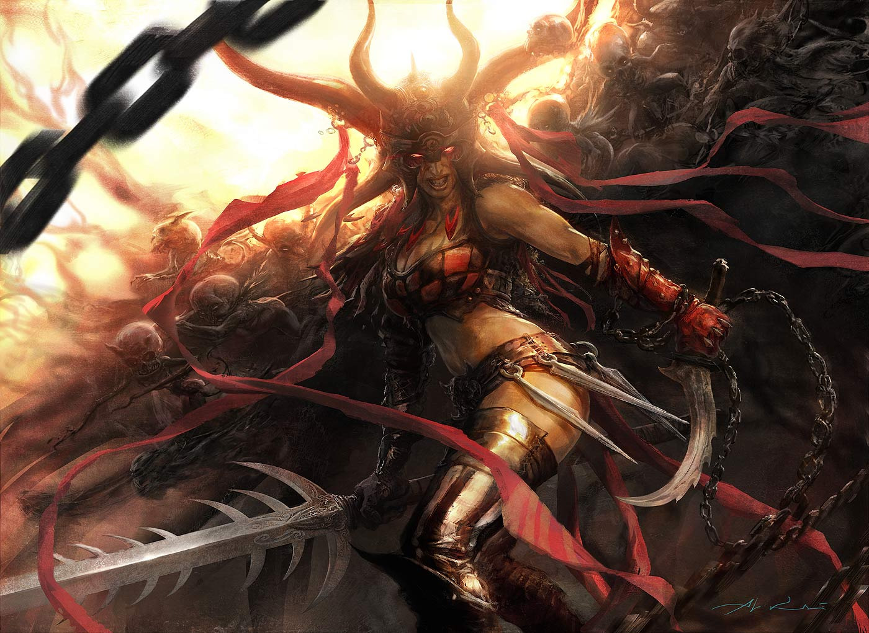
MTG English terms you DON’T need to know
Specific Card Names
Specific Abilities and Keywords
Don’t need to form
complete sentences

Slide 15
Pack Wars!
Pair up.
Play MTG completely in English.
If you don’t know how to say
something clearly, ask your
opponent!
If neither of you know
call a judge!

Slide 16
MTG 英文怎么提高？
L3 英文要求
English competency is only required to the extent necessary to lead a team at a Grand Prix and read official documentation.
MTG Judge blogs
Knowledge Pool: http://blogs.magicjudges.org/knowledgepool/
Policy Perspectives: http://blogs.magicjudges.org/telliott/
Rules Tips: http://blogs.magicjudges.org/rulestips/
Form a support group

Slide 17
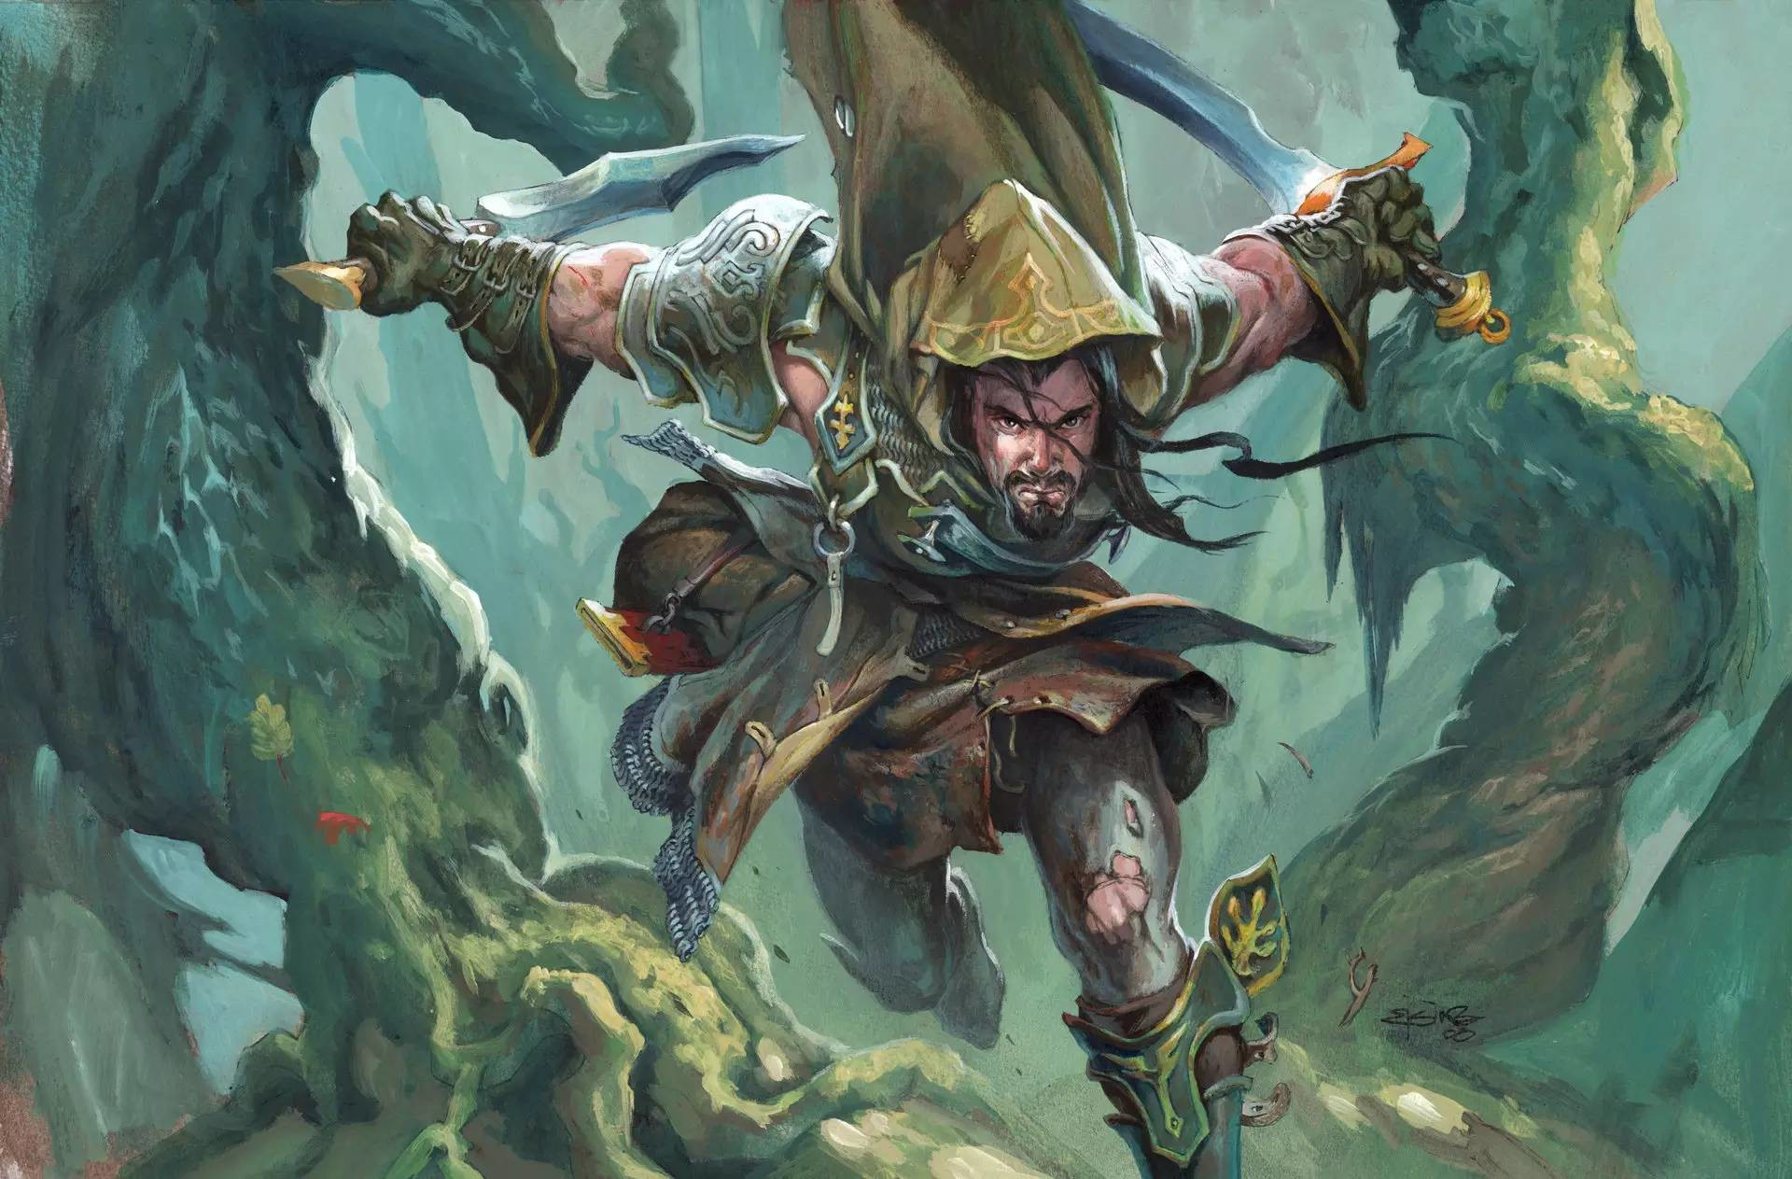
MTG 英文怎么提高？
Find a mentor.
JudgeApps is full of English-speaking judges.
Judge Project 呢？
Talk to the foreign players
in your local store

Slide 18
问题？

